Slide 1
Data Communications
Unit 1

Slide 2
Unit 1: Data Communications (8 Hours)
1.1 Definition, Components of Data Communication
1.2 Data Transmission Modes: Simplex, Half-Duplex, FullDuplex
1.3 Data Representation: Analog and Digital
1.4 Analog and Digital Transmission
1.5 Serial and Parallel Communication
1.6 Asynchronous and Synchronous Transmission
I .7 Transmission Impairments
1.8 Bandwidth, Throughput, Baud Rate, Jitter
1.9 Nyquist and Shannon Capacity Theorem
I. 10 Digital Transmission Techniques

Slide 3
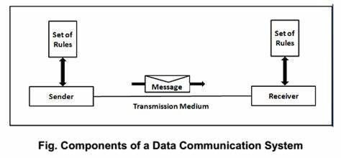
Data communication
Data communication is the process of transferring digital data between two or more devices through a transmission medium, like a cable or wireless connection.
It enables everything from sending an email to browsing the web and relies on a system of hardware, software, and established protocols to ensure data is sent, received, and interpreted correctly

Slide 4
Components of Data Communication
A communication system is made up of the following components:
Message: A message is a piece of information that is to be transmitted from one person to another. It could be a text file, an audio file, a video file, etc.
Sender: It is simply a device that sends data messages. It can be a computer, mobile, telephone, laptop, video camera, or workstation, etc.
Receiver: It is a device that receives messages. It can be a computer, telephone mobile, workstation, etc.
Transmission Medium / Communication Channels: Communication channels are the medium that connect two or more workstations. Workstations can be connected by either wired media or wireless media.
Set of rules (Protocol): When someone sends the data (The sender), it should be understandable to the receiver also otherwise it is meaningless. For example, Sonali sends a message to Chetan. If Sonali writes in Hindi and Chetan cannot understand Hindi, it is a meaningless conversation.

Slide 5
What is Data Transmission?
Data transmission is the transfer of data from one digital device to another.
This transfer occurs via point-to-point data streams or channels.
These channels may previously have been in the form of copper wires but are now much more likely to be part of a wireless network.
Data transmission methods can refer to both analog and digital data but in this guide, we will be focusing on digital modulation.
This modulation technique focuses on the encoding and decoding of digital signals via two main methods parallel and serial transmission.

Slide 6
The data transmission modes can be characterized in the following three types based on the direction of exchange of information:
Simplex
Half-Duplex
Full Duplex

Slide 7
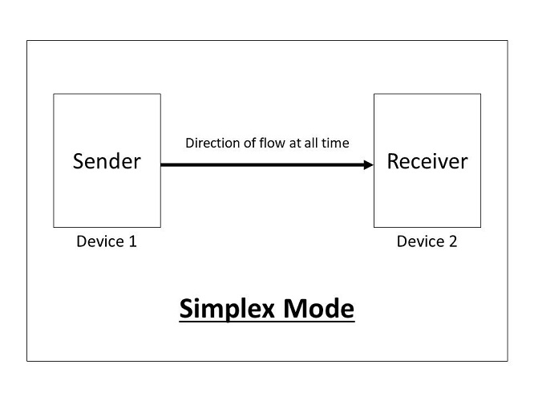
According to the Direction of Exchange of Information:
1.Simplex
Simplex is the data transmission mode in which the data can flow only in one direction, i.e., the communication is unidirectional.
In this mode, a sender can only send data but can not receive it. Similarly, a receiver can only receive data but can not send it.

Slide 8
This transmission mode is not so popular .
It is mainly used in the business field as in sales that do not require any corresponding reply.
It is similar to a one-way street.
For Example, Radio and TV transmission, keyboard, mouse, etc.
Following are the advantages of using a Simplex transmission mode:
It utilizes the full capacity of the communication channel during data transmission.
Following are the disadvantages of using a Simplex transmission mode:
It is unidirectional in nature having no inter-communication between devices.
There is no mechanism for information to be transmitted back to the sender(No mechanism for acknowledgement).

Slide 9
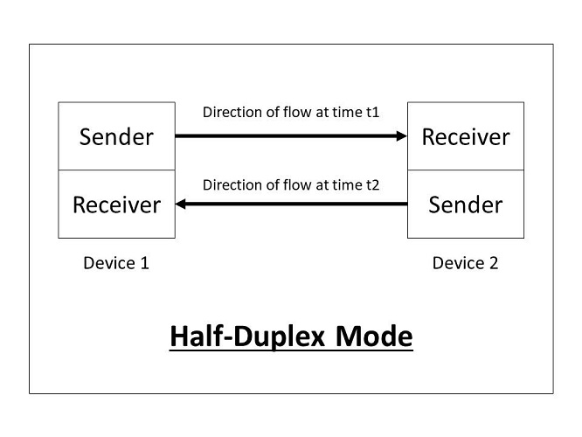
2. Half-Duplex
Half-Duplex is the data transmission mode in which the data can flow in both directions but in one direction at a time.
It is also referred to as Semi-Duplex.
In other words, each station can both transmit and receive the data but not at the same time.
When one device is sending the other can only receive and vice-versa.

Slide 10
In this type of transmission mode, the entire capacity of the channel can be utilized for each direction.
Transmission lines can carry data in both directions, but the data can be sent only in one direction at a time.
For Example, Walkie-Talkie, Internet Browsers, etc.
Following are the advantages of using a half-duplex transmission mode:
It facilitates the optimum use of the communication channel.
It provides two-way communication.
Following are the disadvantages of using a half-duplex transmission mode:
The two-way communication can not be established simultaneously at the same time.
Delay in transmission may occur as only one way communication can be possible at a time.

Slide 11
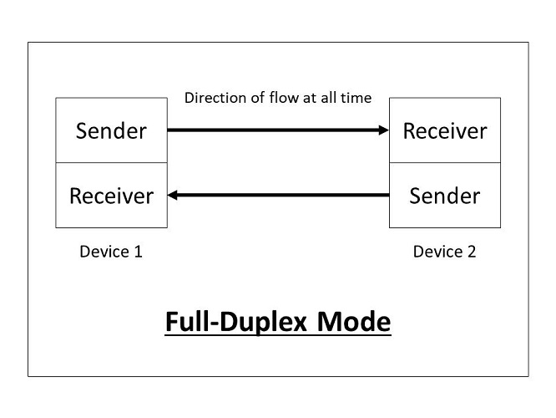
3. Full-Duplex
Full-Duplex is the data transmission mode in which the data can flow in both directions at the same time. It is bi-directional in nature. It is two-way communication in which both the stations can transmit and receive the data simultaneously.
Full-Duplex mode has double bandwidth as compared to the half-duplex.
The capacity of the channel is divided between the two directions of communication.
This mode is used when communication in both directions is required simultaneously.

Slide 12
Following are the advantages of using a full-duplex transmission mode:
The two-way communication can be carried out simultaneously in both directions.
It is the fastest mode of communication between devices.
Following are the disadvantages of using a full-duplex transmission mode:
The capacity of the communication channel is divided into two parts. Also, no dedicated path exists for data transfer.
It has improper channel bandwidth utilization as there exist two separate paths for two communicating devices.

Slide 13
Analog Signals and Digital Signals
A signal is an electromagnetic or electrical current that carries data from one system or network to another.
In electronics, a signal is often a time-varying voltage that is also an electromagnetic wave carrying information, though it can take on other forms, such as current.
There are two main types of signals used in electronics: analog and digital signals.

Slide 14
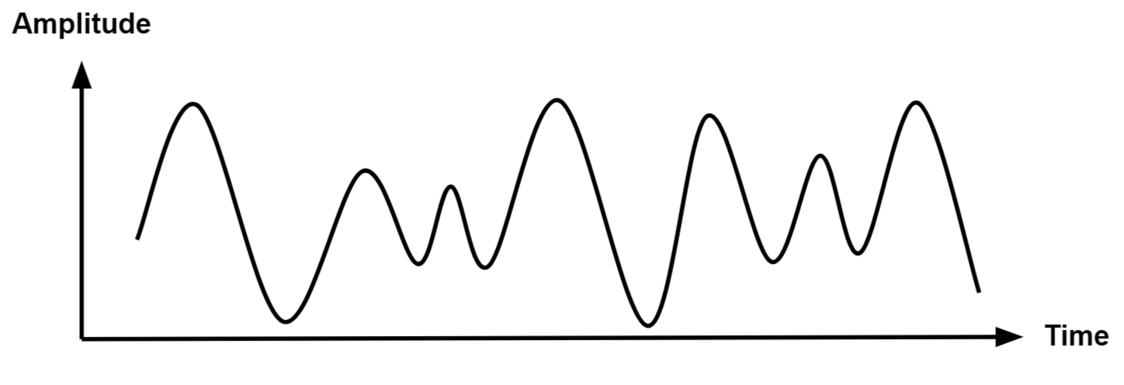
Analog Signal
An analog signal is time-varying and generally bound to a range (e.g. +12V to -12V), but there is an infinite number of values within that continuous range.
An analog signal uses a given property of the medium to convey the signal’s information, such as electricity moving through a wire.
In an electrical signal, the voltage, current, or frequency of the signal may be varied to represent the information.
Analog signals are often calculated responses to changes in light, sound, temperature, position, pressure, or other physical phenomena.

Slide 15
Digital Signal
A digital signal is a signal that represents data as a sequence of discrete values.
A digital signal can only take on one value from a finite set of possible values at a given time.
With digital signals, the physical quantity representing the information can be many things:
Variable electric current or voltage
Phase or polarization of an electromagnetic field,
The magnetization of a magnetic storage media
Digital signals are used in all digital electronics, including computing equipment and data transmission devices.
When plotted on a voltage vs. time graph, digital signals are one of two values, and are usually between 0V and VCC (usually 1.8V, 3.3V, or 5V

Slide 16
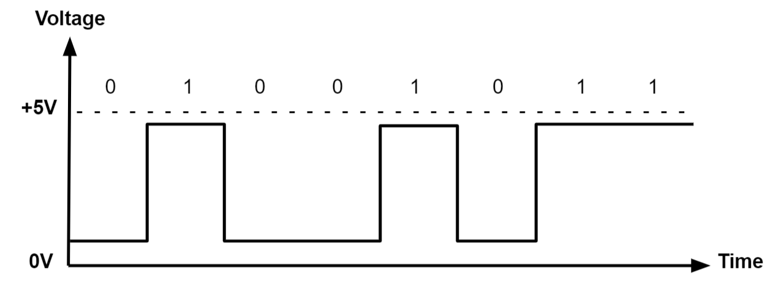

Slide 17
The data transmission modes can be characterized in the following two types based on the number of bits sent simultaneously in the network:
Serial
Parallel

Slide 18
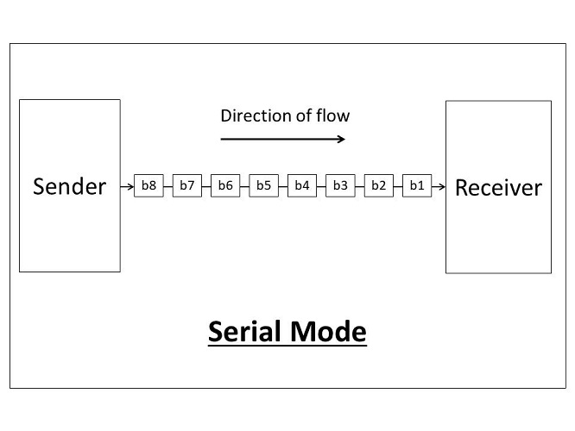
According to the number of bits sent simultaneously in the network:
1. Serial
The Serial data transmission mode is a mode in which the data bits are sent serially one after the other at a time over the transmission channel.

Slide 19
It needs a single transmission line for communication.
The data bits are received in synchronization with one another. So, there is a challenge of synchronizing the transmitter and receiver.
In serial data transmission, the system takes several clock cycles to transmit the data stream.
In this mode, the data integrity is maintained, as it transmits the data bits in a specific order, one after the other.
This type of transmission mode is best suited for long-distance data transfer, or the amount of data being sent is relatively small.
For Example, Data transmission between two computers using serial ports.

Slide 20
Following are the advantages of using a serial transmission mode:
It can be used for long-distance data transmission as it is reliable.
The number of wires and complexity is less.
It is cost-effective.
Following are the disadvantages of using a serial transmission mode:
The Data transmission rate is slow due to a single transmission channel.

Slide 21
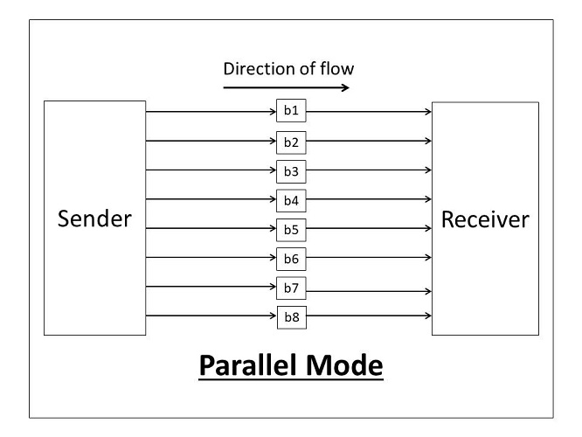
Parallel
The Parallel data transmission mode is a mode in which the data bits are sent parallelly at a time. In other words, there is a transmission of n-bits at the same time simultaneously.

Slide 22
Multiple transmission lines are used in such modes of transmission.
So, multiple data bytes can be transmitted in a single system clock.
This mode of transmission is used when a large amount of data has to be sent in a shorter duration of time.
It is mostly used for short-distance communication.
For n-bits, we need n-transmission lines. So, the complexity of the network increases but the transmission speed is high.
If two or more transmission lines are too close to each other, then there may be a chance of interference in the data, degrading the signal quality.
For Example, Data transmission between computer and printer.

Slide 23
Following are the advantages of using a parallel transmission mode:
It is easy to program or implement.
Data transmission speed is high due to the n-transmission channel.
Following are the disadvantages of using a parallel transmission mode:
It requires more transmission channels, and hence cost-ineffective.
Interference in data bits, likewise in video conferencing.
Hence, after learning the various transmission modes, we can conclude that some points need to be considered when selecting a data transmission mode:
Transmission Rate.
The Distance that it covers.
Cost and Ease of Installation.
The resistance of environmental conditions.

Slide 24
The data transmission modes can be characterized in the following two types based on the synchronization between the transmitter and the receiver: ( Serial )
Synchronous
Asynchronous

Slide 25
According to the synchronization between the transmitter and the receiver:
1. Synchronous
The Synchronous transmission mode is a mode of communication in which the bits are sent one after another without any start/stop bits or gaps between them.
Actually, both the sender and receiver are paced by the same system clock.
In this way, synchronization is achieved.
In a Synchronous mode of data transmission, bytes are transmitted as blocks in a continuous stream of bits.
Since there is no start and stop bits in the message block.
It is the responsibility of the receiver to group the bits correctly.
The receiver counts the bits as they arrive and groups them in eight bits unit.
The receiver continuously receives the information at the same rate that the transmitter has sent it.
It also listens to the messages even if no bits are transmitted.
In synchronous mode, the bits are sent successively with no separation between each character, so it becomes necessary to insert some synchronization elements with the message, this is called " Character-Level Synchronization ".

Slide 26
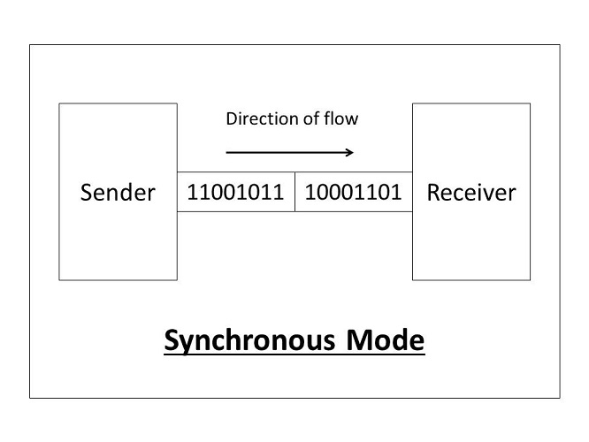
For Example, if there are two bytes of data, say(10001101, 11001011) then it will be transmitted in the synchronous mode as follows:
For Example, communication in CPU, RAM, etc.
Following are the advantages of using a Synchronous transmission mode:
Transmission speed is fast as there is no gap between the data bits.
Following are the disadvantages of using a Synchronous transmission mode:
It is very expensive.

Slide 27
2. Asynchronous
The Asynchronous transmission mode is a mode of communication in which a start and the stop bit is introduced in the message during transmission.
The start and stop bits ensure that the data is transmitted correctly from the sender to the receiver.
Generally, the start bit is '0' and the end bit is '1'.Asynchronous here means 'asynchronous at the byte level', but the bits are still synchronized.
The time duration between each character is the same and synchronized.
In an asynchronous mode of communication, data bits can be sent at any point in time.
The messages are sent at irregular intervals and only one data byte can be sent at a time.
This type of transmission mode is best suited for short-distance data transfer.

Slide 28
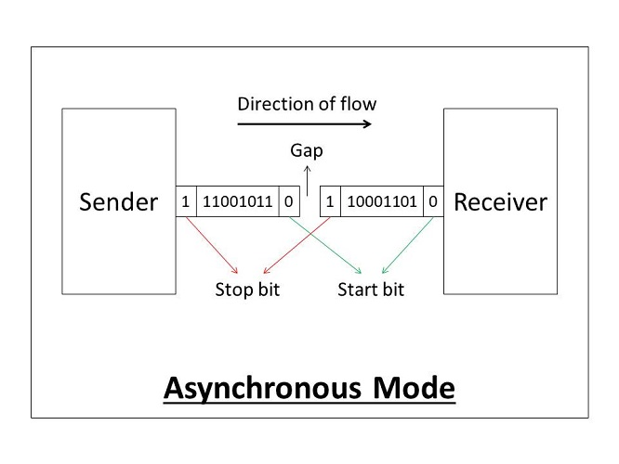
For Example, if there are two bytes of data, say(10001101, 11001011) then it will be transmitted in the asynchronous mode as follows:
Example, Data input from a keyboard to the computer.
Following are the advantages of using an Asynchronous transmission mode:
It is a cheap and effective mode of transmission.
Data transmission accuracy is high due to the presence of start and stop bits.
Following are the disadvantages of using an Asynchronous transmission mode:
The data transmission can be slower due to the gaps present between different blocks of data.

Slide 29
Bandwidth
Wireless communications are normally carried out over a limited range of frequencies, known as a frequency band.
This frequency band is known as the bandwidth.
It is a networking term that refers to the maximum quantity of data that may be sent per unit of time.
In technical terms, bandwidth is frequency range within a given band that is typically used for signal transmission.
Signal bandwidth refers to the frequency range that makes up a specific signal.

Slide 30
Frequency
The term "frequency" defines the number of oscillations that happen in a data transmission per second.
In terms of networking, the data is transmitted in the form of signals, which are composed of waves.
The number of oscillations per second specifies the signal frequency.
It is commonly measured in Hertz (Hz).
In the event of sound, frequency is a measure of the pitch of the sound: High-frequency sounds have a high pitch ("treble"), while low-frequency sounds have a low pitch ("bass").

Slide 31
Throughput
Definition: Throughput is the actual amount of data successfully transmitted through a network in a given time.
Unit: Also measured in bps, Kbps, Mbps, etc.
Example: Even if your bandwidth is 100 Mbps, your throughput might only be 80 Mbps due to interference, congestion, or other network delays.
Analogy: If bandwidth is the highway’s capacity, throughput is how many cars actually get through during rush hour.

Slide 32
Baud Rate
Definition: Baud rate is the number of signal changes or symbols sent per second over a communication channel.
Unit: Measured in Baud (Bd) = symbols per second.
Example: If a signal changes 1000 times per second, the baud rate is 1000 baud. If each symbol represents 2 bits, then data rate = 1000 × 2 = 2000 bps.
Note: Data rate (bits per second) = Baud rate × number of bits per symbol.

Slide 33
Jitter
Definition: Jitter is the variation in packet arrival time during data transmission.
Unit: Measured in milliseconds (ms).
Example: If packets are supposed to arrive every 10 ms, but some arrive at 8 ms or 15 ms, that variation is jitter.
Effect: High jitter can cause problems in real-time applications like video calls, VoIP, or online gaming — leading to lag or choppy audio/video.
Analogy: If you’re getting on a bus that’s supposed to come every 10 minutes, but it sometimes comes after 5 minutes or 15 minutes — that’s like network jitter.

Slide 34
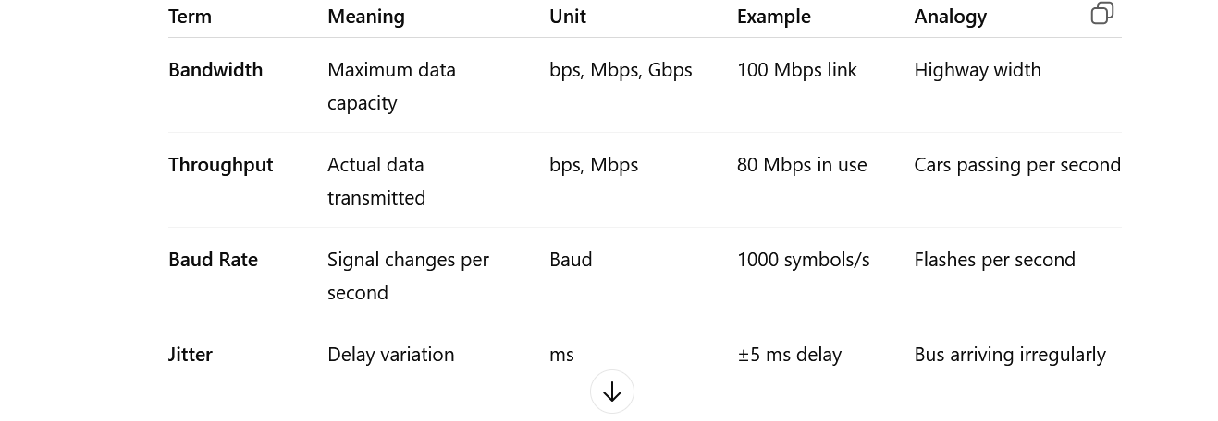

Slide 35
Transmission impairment
Transmission impairment occurs when the received signal is different from the transmitted signal.
As we know, a signal can be transmitted as Analog signal or it can be transmitted as a digital signal.
There are various causes of transmission impairments −
Noise
Distortion
Attenuation

Slide 36
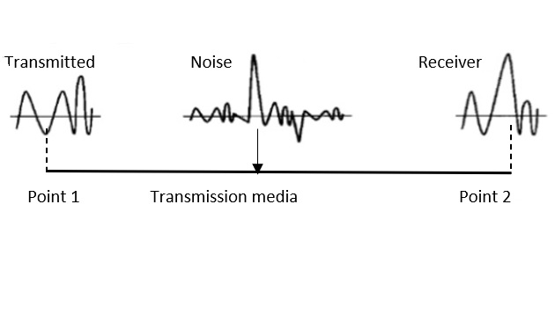
Noise
Noise is the major factor for the transmission distortion as any unwanted signal gets added to the transmitted signal by which the resulting transmitted signal gets modified and at the receiver side it is difficult to remove the unwanted noise signal.
These noises are various kinds like shot noise, impulse noise, thermal noise etc.
Noise is diagrammatically represented as follows −

Slide 37
Distortion
This kind of distortion is mainly appearing in case of composite signals in which a composite signal has various frequency components in it and each frequency component has some time constraint which makes a complete signal.
But while transmitting this composite signal, if a certain delay happens between the frequencies components, then there may be the chance that the frequency component will reach the receiver end with a different delay constraint from its original which leads to the change in shape of the signal.
The delay happens due to environmental parameters or from the distance between transmitter and receiver etc.
Distortion is diagrammatically represented as follows −

Slide 38
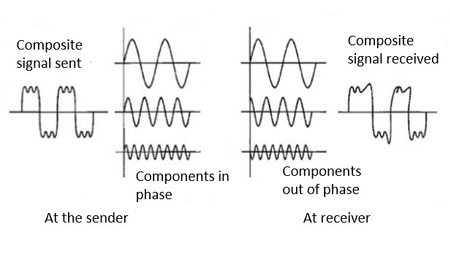

Slide 39
3.attenuation
Attenuation is a general term that refers to any reduction in the strength of a signal.
Attenuation occurs with any type of signal, whether digital or analog. Sometimes called loss, attenuation is a natural consequence of signal transmission over long distances.

Slide 40
Digital Transmission Techniques
Digital transmission refers to sending digital signals (0s and 1s) over a communication medium (wire, fiber, wireless).
To send digital data efficiently and correctly, several techniques are used.
Digital transmission techniques are mainly divided into:

Slide 41
1. Line Coding
Line coding means converting digital data (bits) into a digital signal that can be sent over a channel.
Common Line Coding Schemes:
a) Unipolar NRZ
1 = positive voltage
0 = zero voltage
Simple but has DC component.
b) Polar NRZ
1 = positive voltage
0 = negative voltage
Better than unipolar.
c) Manchester Coding
Each bit has a transition in the middle.
1 = high → low
0 = low → high
Self-clocking, easy to decode.
d) Differential Manchester
Always a mid-bit transition.
Difference of start transition determines 0 or 1.

Slide 42
2. Block Coding
Block coding adds redundancy to detect errors.
Example: 4B/5B coding
4 data bits → 5-bit code
Ensures enough transitions for synchronization.

Slide 43
3. Scrambling
Scrambling eliminates long sequences of 0s or 1s so that clock recovery becomes easier.
Examples:
B8ZS (Bipolar 8-Zero Substitution)
HDB3 (High-Density Bipolar 3)
Used in telephone networks.

Slide 44
4. Digital Modulation Techniques
Used to send digital data over analog channels (like radio, telephone lines).
There are 3 main categories:
a) ASK (Amplitude Shift Keying)
Amplitude changes with bit.
1 = high amplitude
0 = low amplitude
b) FSK (Frequency Shift Keying)
Frequency changes.
1 = high frequency
0 = low frequency
c) PSK (Phase Shift Keying)
Phase changes.
Most reliable for modern systems.
Variants:
BPSK (1 bit per symbol)
QPSK (2 bits per symbol)
8-PSK, 16-PSK
d) QAM (Quadrature Amplitude Modulation)
Combines amplitude + phase.
Used in WiFi, 4G/5G, cable TV.
Examples: 16-QAM, 64-QAM, 256-QAM.

Slide 45
5. Pulse Shaping
Used to reduce intersymbol interference.
Examples:
NRZ pulses
RZ pulses
Raised Cosine Filter

Slide 46
6. Multiplexing
Used to transmit multiple signals over a single channel.
Types:
TDM (Time Division Multiplexing)
FDM (Frequency Division Multiplexing)
CDMA (Code Division Multiple Access)

